Slide 1

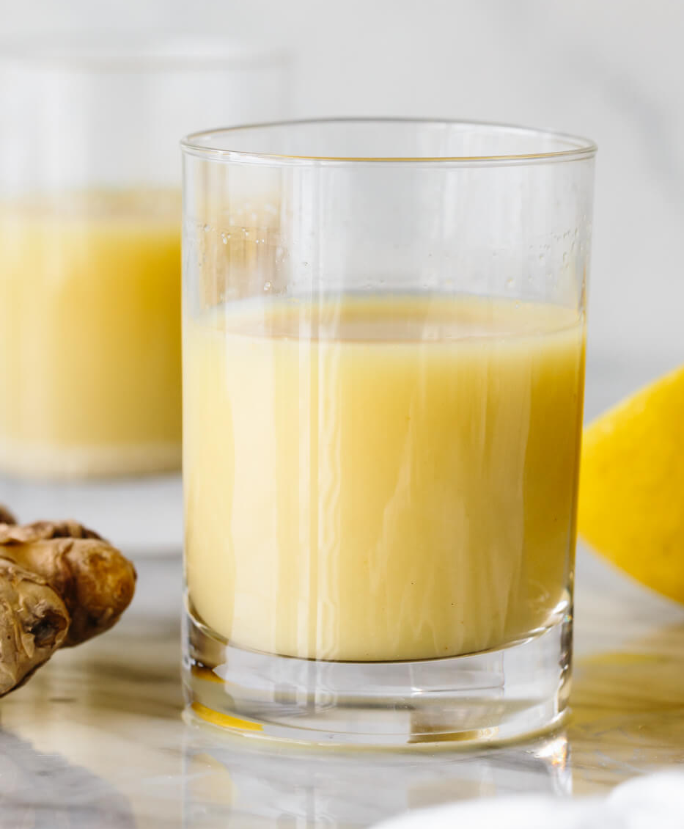
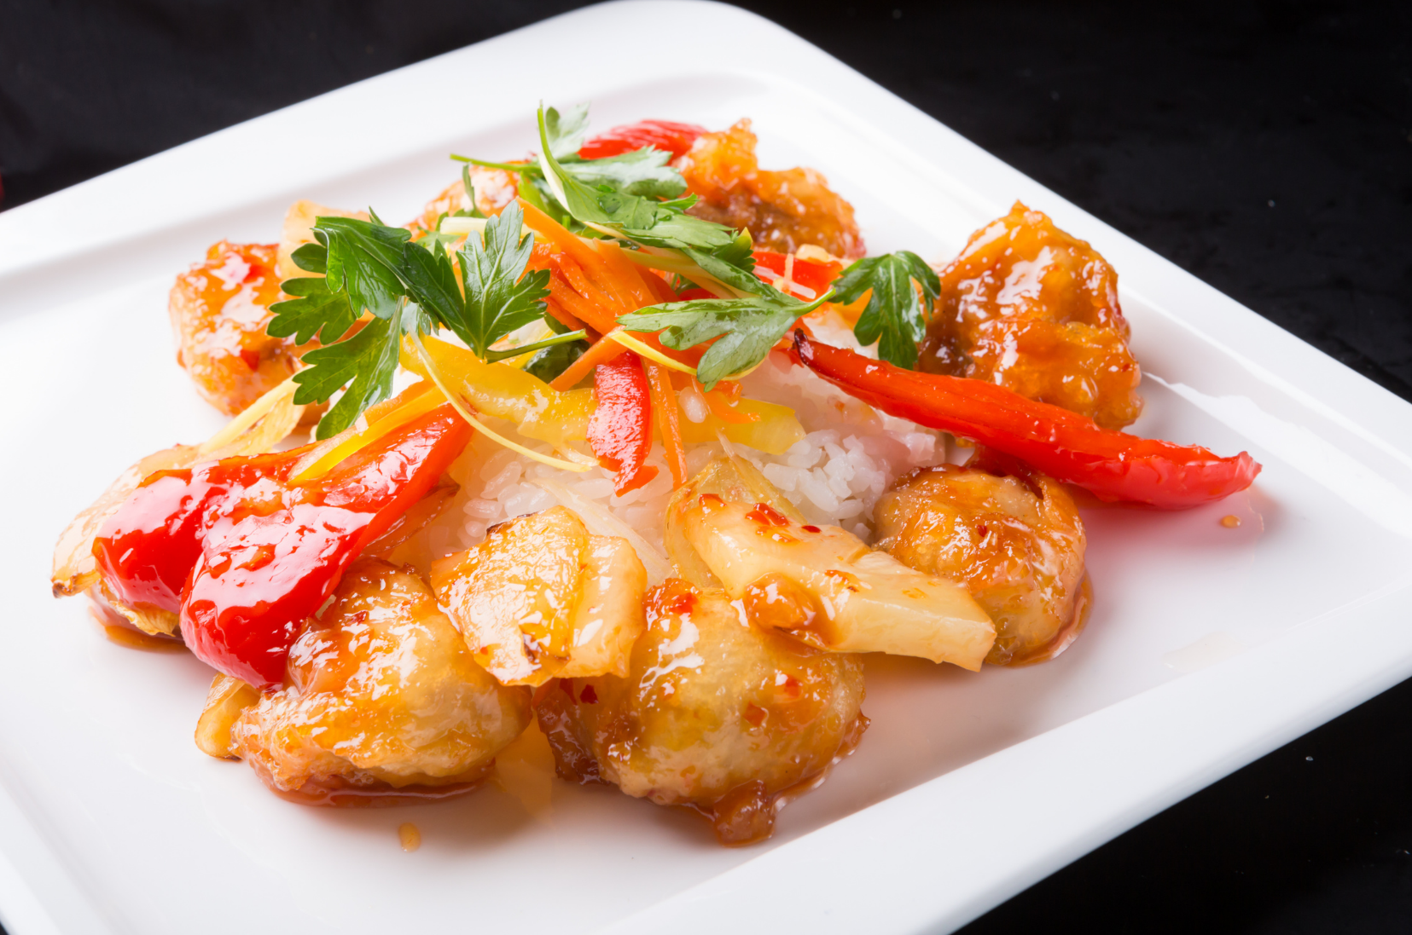

Example Diet Plan
 | Breakfast | Snack | Lunch | Snack | Evening Meal | Pre-bed
Monday | Scrambled egg x3 Spinach Toast x2 | Ginger shot | 1x portion lean protein (chicken/fish) 2x ladles rice Vegetables (Choose freely) | Nuts: (25g of cashews OR pistachios) Fresh fruit: Apple or banana | 2x portion lean protein (chicken/fish) 1x ladles rice/pasta Vegetables (Choose freely) | Protein shake Whey (30g + semi skimmed milk)
Click for recipe
Recipe or purchase
Goals
Lean protein at each meal
Complex carbohydrates around training and matches
Healthy fats
Limit
Simple sugars
Refined foods
Alcohol
Protein
Tuesday | Porridge with skimmed milk 1x tbsp almond butter & blueberries | Greek yoghurt and raspberries (250g yoghurt) | 2x portion lean protein (chicken/fish) 2x ladles rice Vegetables (Choose freely) | Protein shake | Sweet Chilli Chicken with salad | Semi-skimmed milk 300mL
Immunity
Click for recipe
Wednesday | Omelette x3 eggs Spinach Peppers | Red Berry smoothie (50g red berries, raspberries, strawberries and blue berries, banana + 150mL milk) | Chicken & pineapple skewers (2x chicken breast) Mixed vegetables (broccoli, cauliflower, carrot and asparagus | Coconut protein balls x2 | Grilled salmon (110g) Rice (1 x ladles) Steamed veg (broccoli, cauliflower, carrot and asparagus) | Semi-skimmed milk 300mL
Recovery
Immunity
Click for recipe
Carbohydrate
Thursday | Scrambled eggs (2x eggs) Toast x 1 Half avocado |  | 1x portion lean protein (chicken/fish) 2x ladles rice Vegetables (Choose freely) |  | 1x portion lean protein (chicken/fish) 3x ladles rice/pasta Vegetables (Choose freely) | Semi-skimmed milk 300mL
 |  | Ginger shot

Slide 2
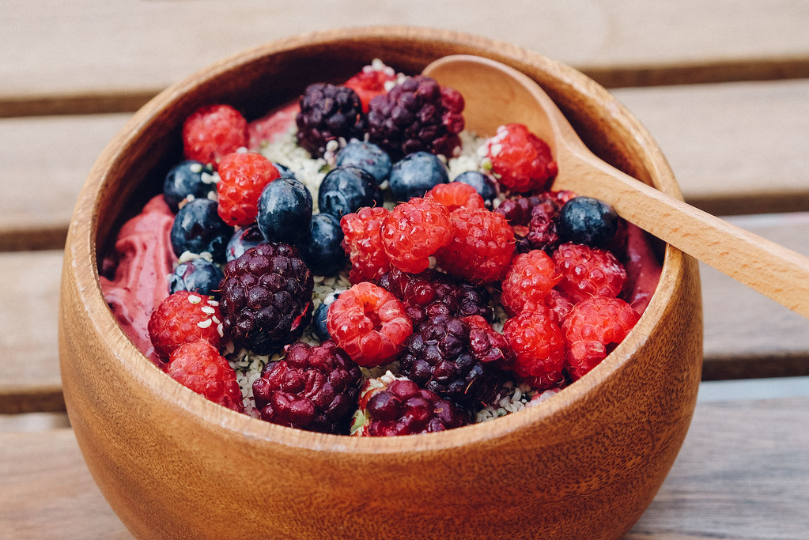
Example Diet Plan
 | Breakfast | Snack | Lunch | Snack | Evening Meal | Pre-bed
Friday | Scrambled egg x3 Spinach Toast x2 | Acai bowl | 1x portion lean protein (chicken/fish) 3x ladles rice Vegetables (Choose freely) | Nuts: (25g of cashews OR pistachios) Fresh fruit: Apple or banana | Grilled chicken breast (2 x breast) 3x ladles rice/pasta Vegetables (Choose freely) | Semi-skimmed milk 300mL
Click for recipe
Goals
Lean protein at each meal
Complex carbohydrates around training and matches
Healthy fats
Limit
Simple sugars
Refined foods
Alcohol
Carb up for Saturday
Protein
No desserts or yoghurt
E.g., Match Day
Saturday | Wholegrain toast x2 Scrambled eggs Low Fat Fruit Yoghurt Sliced Fresh Fruit |  | Fish or chicken Spaghetti with tomato sauce Green beans and carrots | Gels/sports drink as per pre match | Grilled salmon (110g) Couscous (45g Uncooked) Steamed veg (broccoli, cauliflower, carrot and asparagus) | Semi-skimmed milk 300mL
Carb up for match
Sunday | Omelette x3 eggs Spinach Peppers |  | Chicken & pineapple skewers (2x chicken breast) Mixed vegetables (broccoli, cauliflower, carrot and asparagus | Protein shake | Meat Balls Potato wedges Mix sautéed vegetables (Broccoli, carrots) | Semi-skimmed milk 300mL
Recovery Day – Low Carb
Recovery

Slide 3
Recipes
Sweet Chilli Chicken It packs a real punch of flavour and works as an accompaniment to rice, stir fry or even a great salad. Take your pick!! | Coconut Protein Balls A tasty and macronutrient balanced alternative
Ingredients: Serves 2 2 Skinless chicken breasts 2 cloves of garlic 1 thumb size piece of ginger 2 tsp dark soy sauce 4 tbsp sweet chilli sauce 1/2 tsp Paprika (not hot or smoked) 1/2 tsp sesame oil 1 tsp olive oil | Ingredients: Makes 10 2 scoops, chocolate protein powder 19 gram, Milled seeds with flax & chia 60 g, Whole Earth Crunchy Peanut Butter 29 g, Bournville Cocoa Powder 14 g, Manuka Honey 3 teaspoon, coconut oil 20 gram, desiccated coconut (plus extra for covering) 25 gram, dark chocolate chips 45 g, Medjool Dates
Method: Pre-heat oven to 200°C Cut the chicken into strips (5 per breast) Place the garlic and ginger into a food processor along with the Paprika, sesame oil and olive oil and blitz to a puree, then coat the chicken in the marinade place into a freezer bag and allow to work its magic for 1 hour. (Overnight is even better) Pre-heat a frying pan and add a little extra oil the sear the chicken for 10-20 seconds on each side to get a nice charred flavour. Place the chicken onto a baking sheet and coat with the sweet chilli and soy sauce mixture. Place into the oven for 10-12 minutes and serve with your choice of side dishes. | Method: Add all the ingredients into a food processor. You may need to add water as necessary until all the ingredients have combined. Roll into a ball, place in a bowl for 20 minutes in the fridge Separate the into 10 small balls, roll in coconut, place in freezer for 20min. Enjoy Nutrition: Per ball 137kcal|8g Protein| 8g Carbohydrate| 8g Fat

Slide 4
Recipes
Ginger Shots Powerful anti-inflammatory, immune-boosting, and antioxidant properties. | Acai Bowl Packed with antioxidants, vitamins, minerals, fibre, protein, and healthy fats
Ingredients: Serves 1 1/4 cup ginger root, washed, roughly chopped 1/3 cup lemon juice, from 3-4 lemons 1/4 cup coconut water pinch or two cayenne pepper | Ingredients: Serves 2 1 small ripe mango, stoned, peeled and cut into chunks 200g pineapple, peeled, cored and cut into chunks 2 ripe bananas 2 tbsp coconut yogurt (not coconut-flavoured yogurt) 150ml coconut drinking milk 2 passion fruits, halved, seeds scooped out handful blueberries 2 tbsp coconut flakes a few mint leaves
Method: Wash and chop ginger root. Roughly chop it to make blending easier. Juice fresh lemons. Blend until smooth. Blend the ginger pieces and lemon juice until no chunks of ginger remain. Strain well. Press the solids with the back of a spoon. Serve. | Method: Put the mango, pineapple, bananas, yogurt and coconut milk in a blender, and blitz until smooth and thick. Pour into two bowls and decorate with the passion fruit, blueberries, coconut flakes and mint leaves. Will keep in the fridge for 1 day. Add the toppings just before serving.

